Slide 1
Finding the Right Bug Spray
Asya Kamsky
Notes:
High level point of slide
Outline of talking points
Exposition

Slide 2




What bug spray should I use?
Dynamic tools Static tools
What exactly is a bug?
What are you hunting?
How do the sprays work?
What are the pros?
What are the cons?
How can I use them today?

Slide 3
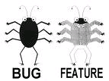
What exactly is a bug?
A bug is an incorrect behavior that is observed when executing the code
A bug is a flaw in the source code that leads to observable incorrect behavior when that code is executed
A bug is a flaw in the source code that could lead to incorrect behavior when that code is executed
A bug is a flaw in the source code that developers agree is bad code

Slide 4
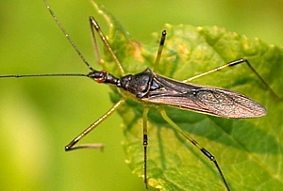
What type of bugs are you hunting?
Bugs for people
  Is the blue button red?
  Is the interface usable?
Bugs for machines
  Primarily coding mistakes
  Bugs that hurt right now
  Bugs that will hurt later

Slide 5
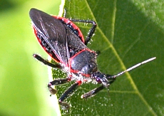
How do the sprays work?
Dynamic tools do their dirty work at run time
  A dynamic analysis tool is a tool that instruments the executable in some way to observe the runtime behavior of that executable in specific executions.
Static tools do their dirty work at compile time
  A static analysis tool is a tool that combs through the source code looking for flaws in the source code itself, not the resulting executable

Slide 6
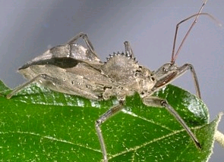
What are the pros?
Dynamic tools
  Typically excel at detecting dynamic memory corruption and resource leak defects
  Pinpoint precisely what went wrong in a given execution trace of the programs
  Very low false positive rate
  Obviously relevant results
Static tools
  Can detect a wide range of coding flaws
  No test cases required to find problems
  Faster and many more possible results (10x or more)
  Bugs are uncovered very early in the SDLC

Slide 7

What are the cons?
Dynamic tools
  Only as good as your existing testsuite
  Potential performance implications that mask bugs (non-determinism)
  Bugs are discovered later in the SDLC
  False negatives
Static tools
  Watch out for the false positive problem!
  Incomplete information about the code
  Can be very superficial if it doesn’t understand how your software is built from the source code

Slide 8

How can I use them today?
Dynamic tools (e.g., Purify, Valgrind)
  How does it instrument my code?
  What type of performance hit does it impose?
  Does it find the bugs that are killing me now?
Static tools (e.g., SPLint, Coverity)
  What does it do to really understand my build system and code?
  What is the false positive rate?
  Can I really understand the results it reports to me?
Cost of implementation…

Slide 9
What bug spray should I use?
Dynamic and Static tools
Complementary technologies
Set expectations correctly
Leverage strengths of each
Write better code…

